Slide 1
Analysis of Starbucks’ Global Presence

Slide 2
Research Questions
What countries have the most Starbucks locations? Are there trends we are seeing across the globe?
2. Can we infer from this data how Starbucks choose a country in which to operate?
3. What country currently without Starbucks could be a potential for a new location?

Slide 3
What countries have the most Starbucks locations?Are there trends we are seeing across the globe?
Data from kaggle.com
Regions
Americas - North , South America and Central America
Asia and Oceania
Europe and Africa

Slide 4
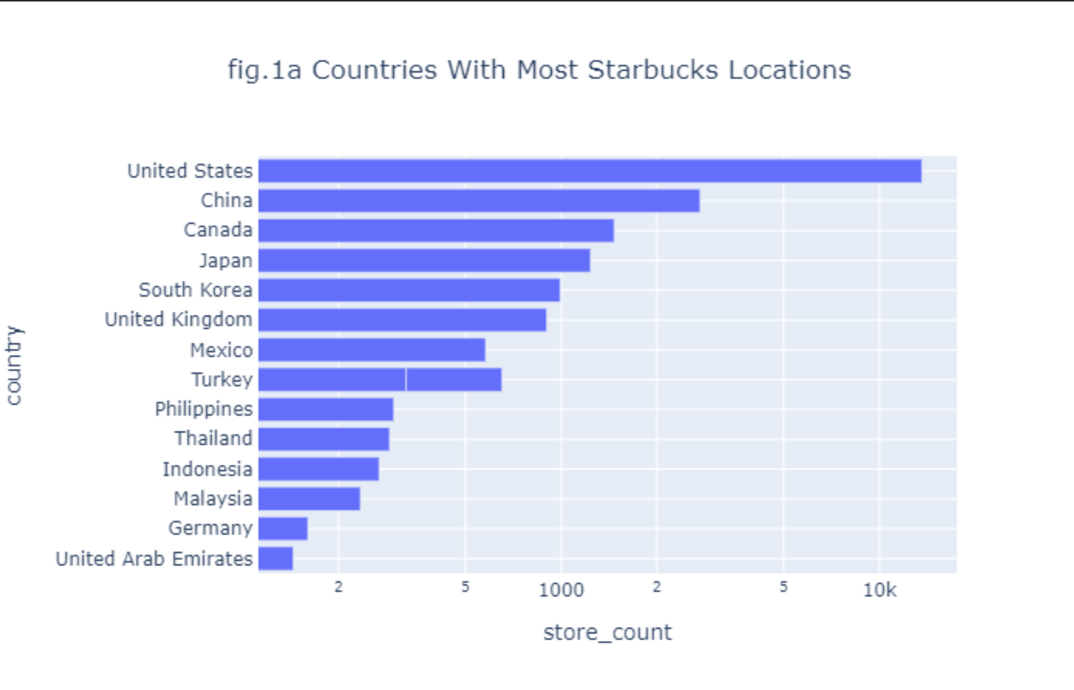

Slide 5
Are there trends we are seeing across the globe?
Data from Starbucks 2016 10-k

Slide 6
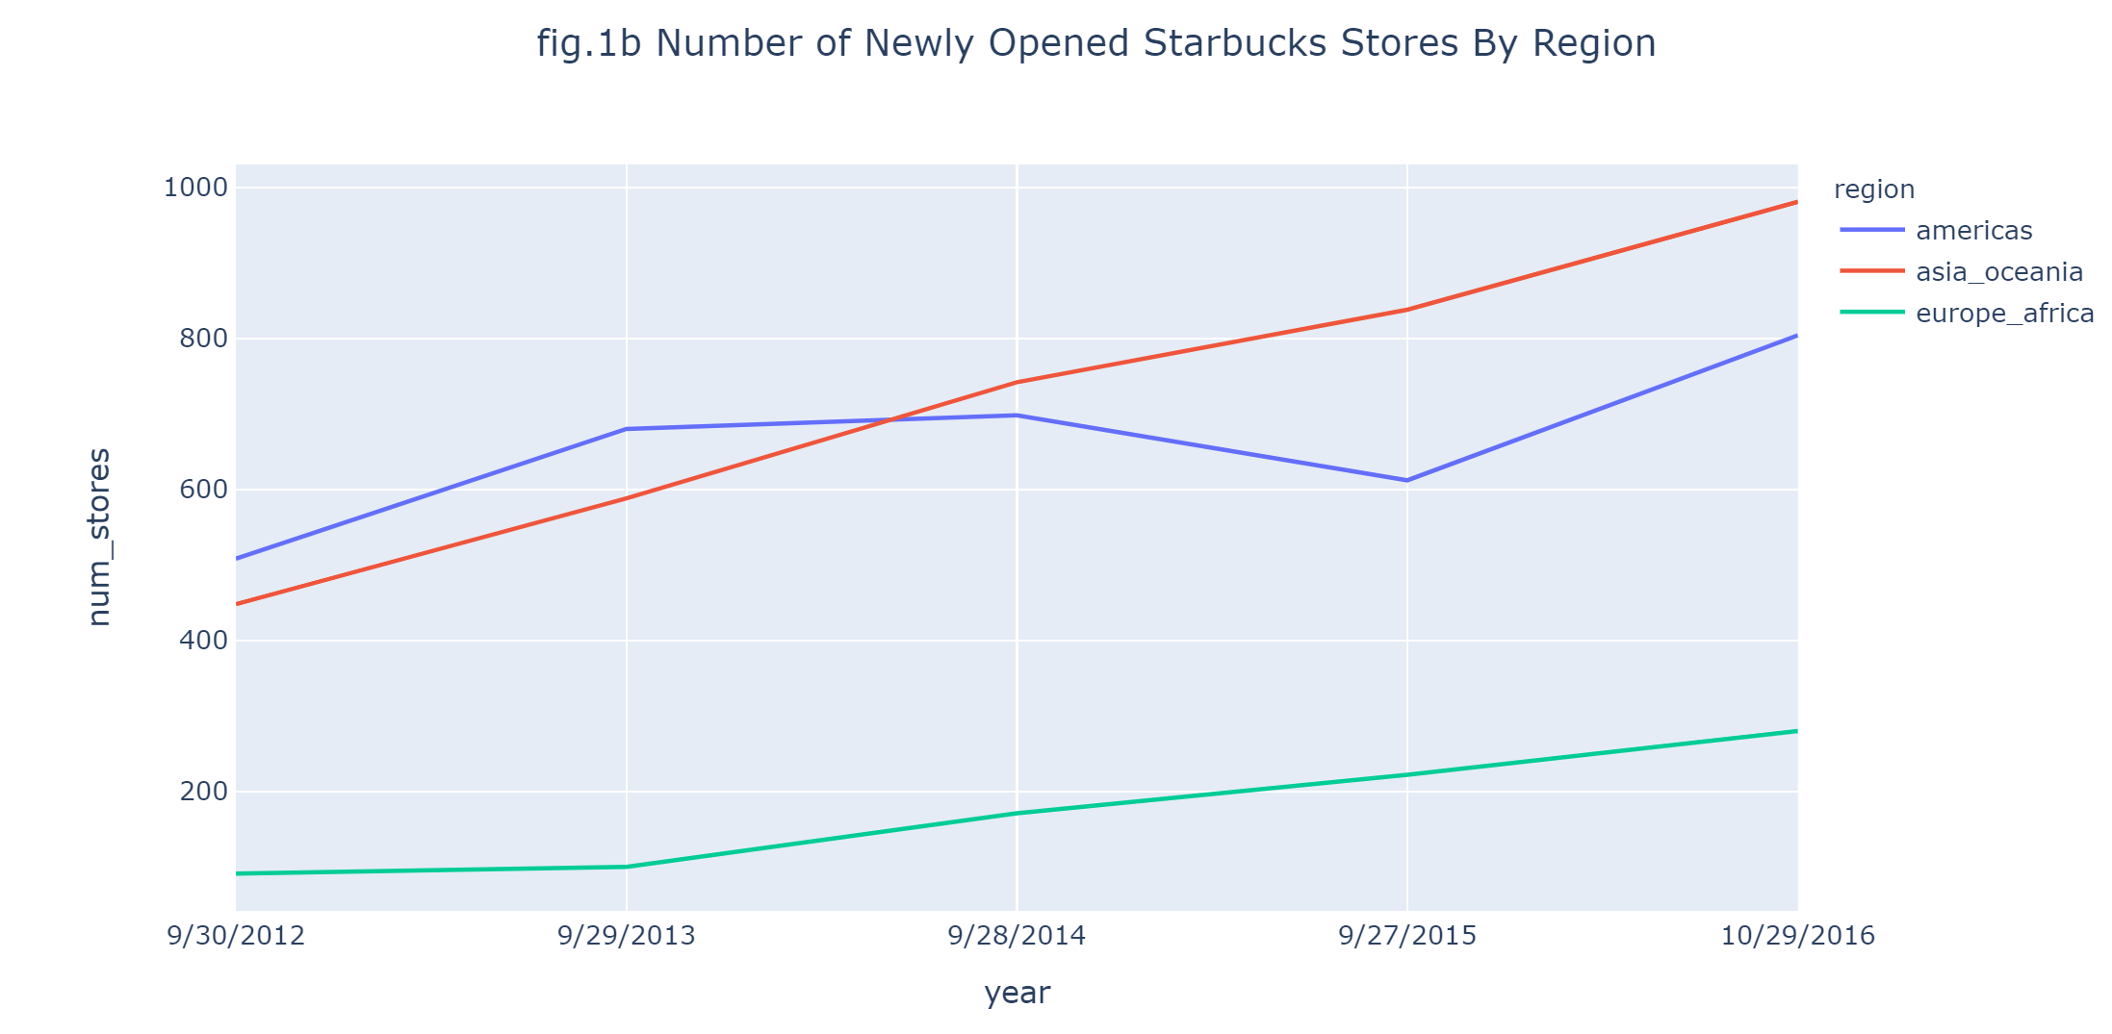

Slide 7
Can we infer from this data how Starbucks chose a country in which to operate?
GDP(PPP) per capita - data from World Bank
Population- data from Worldometer
Ease of doing business- data from World Bank
Coffee consumption - data from ICO

Slide 8
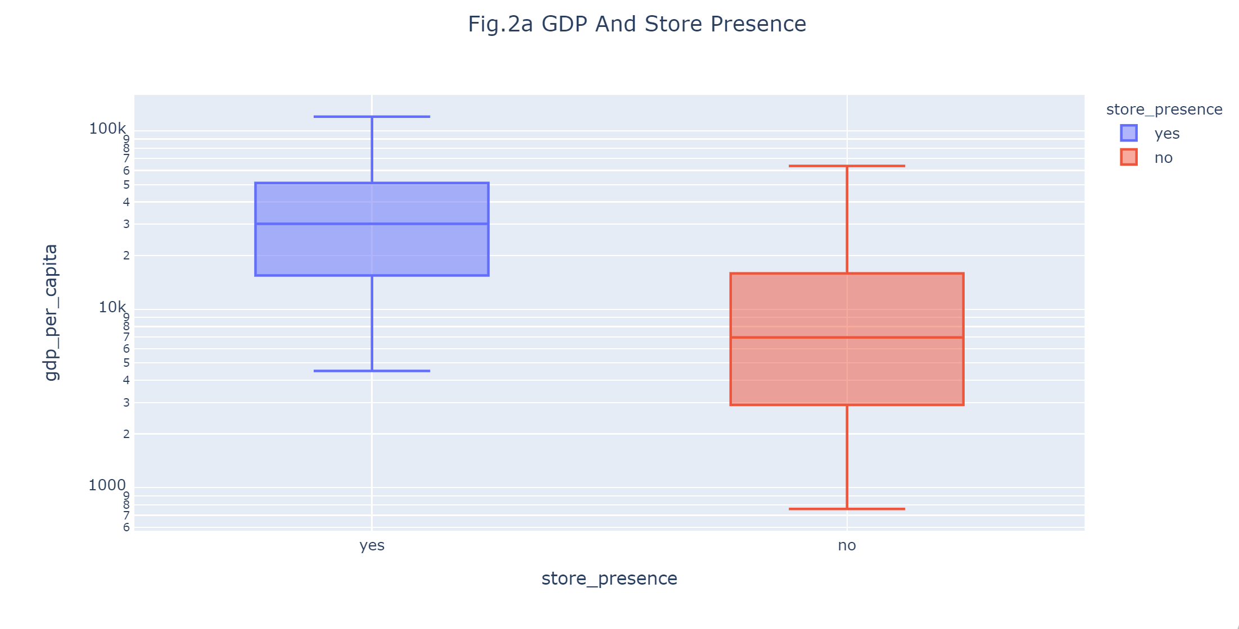
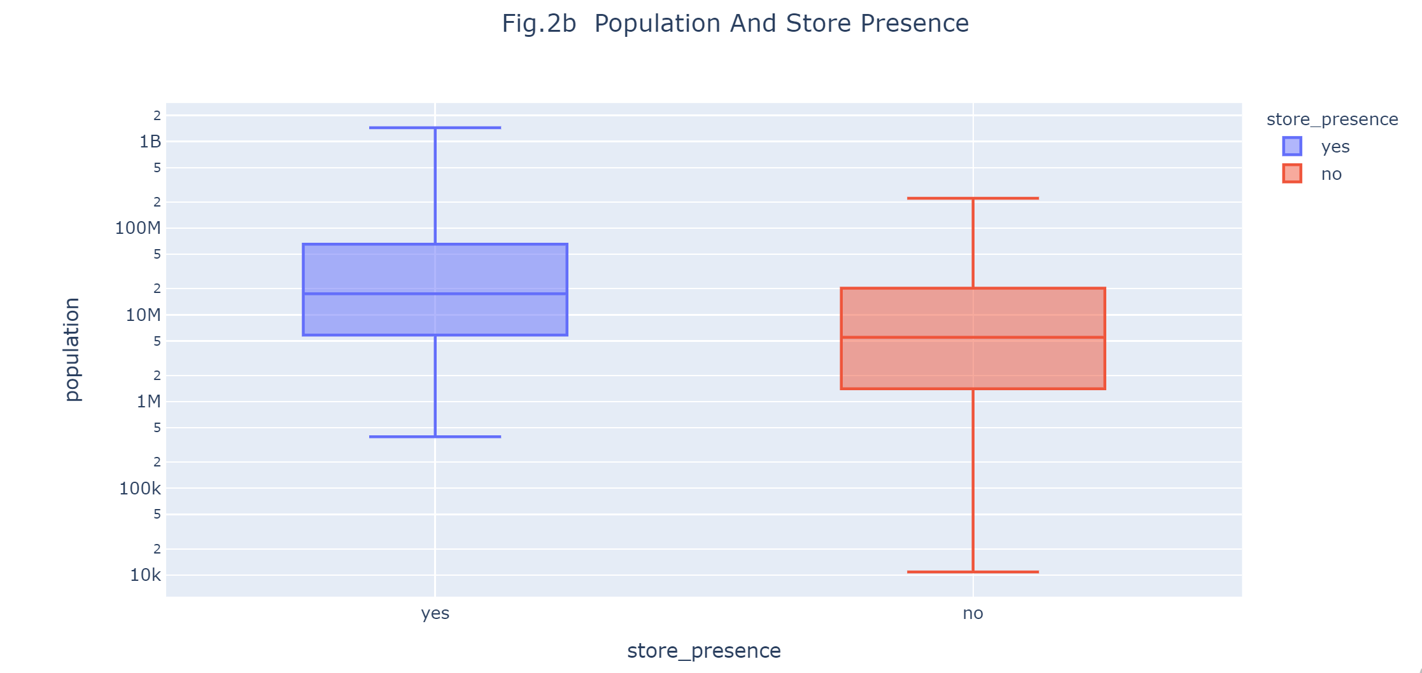
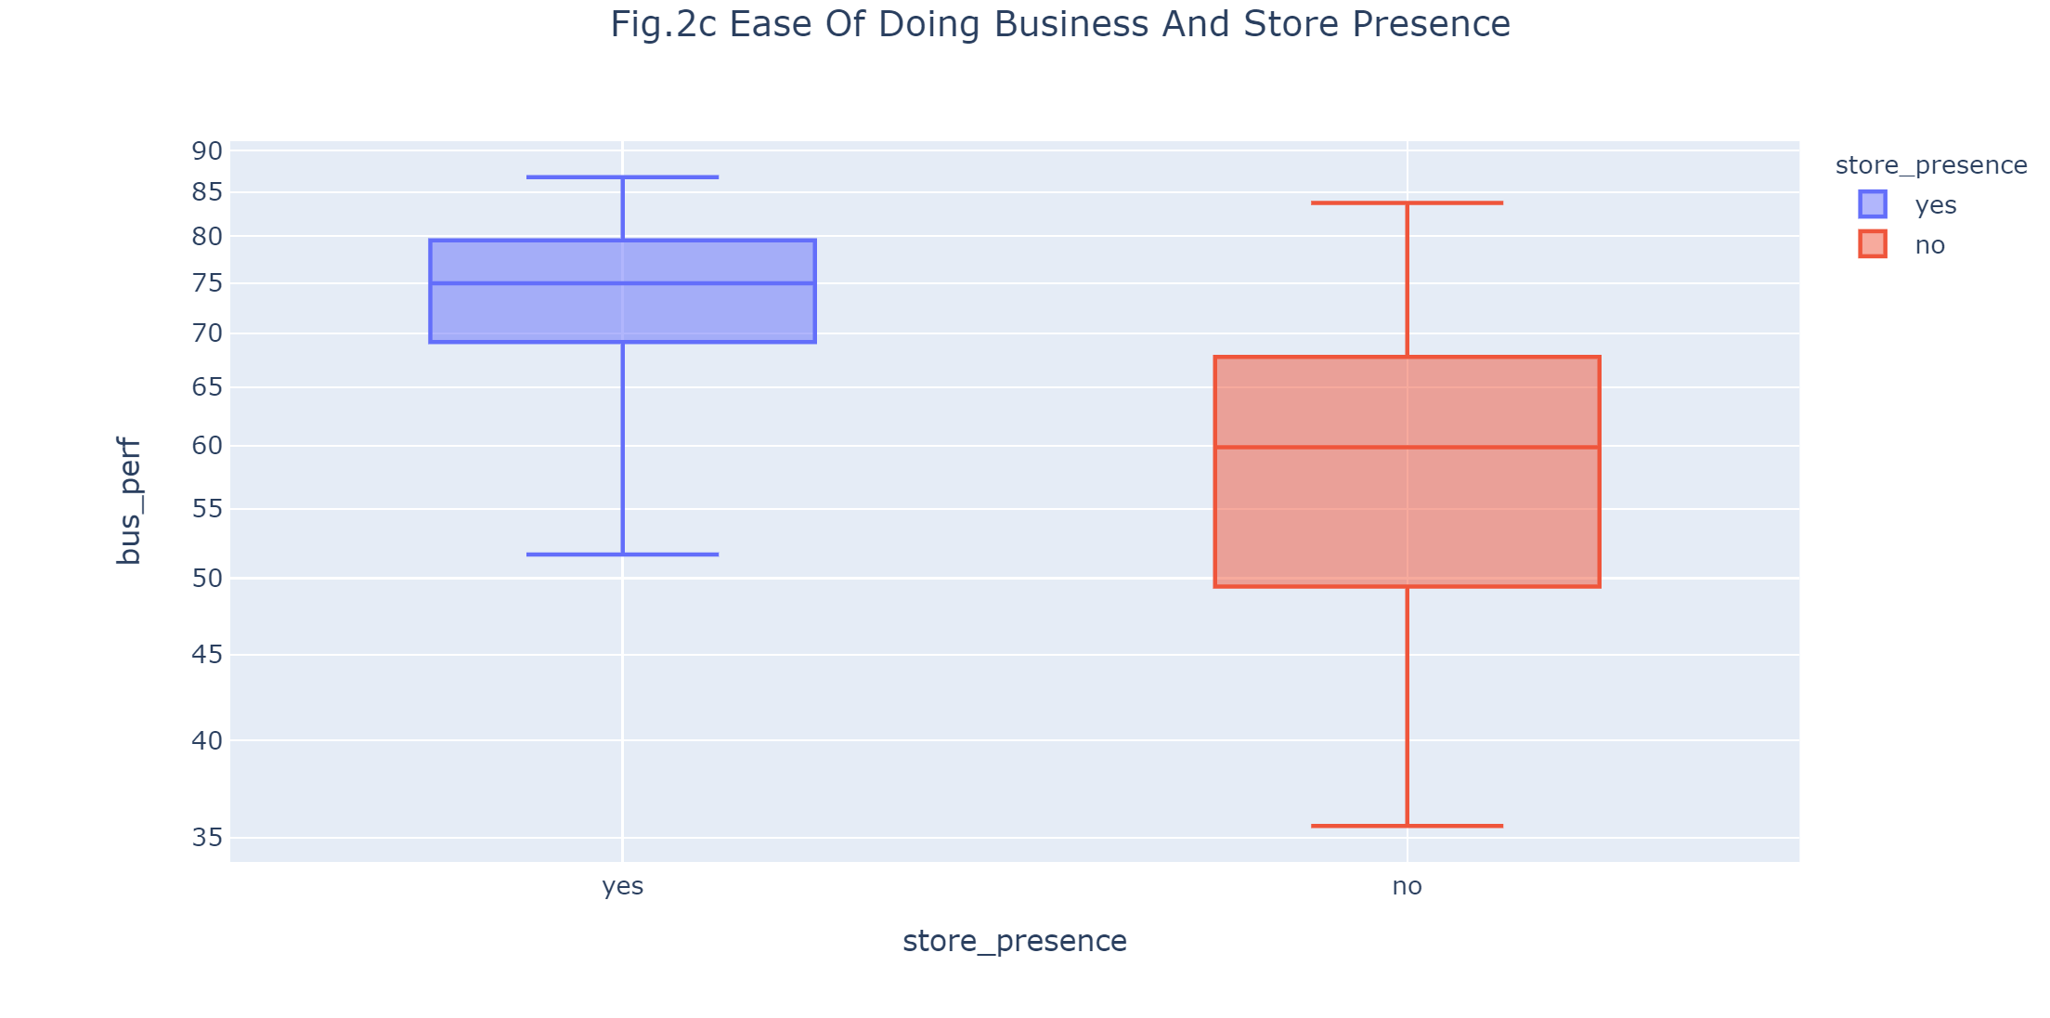
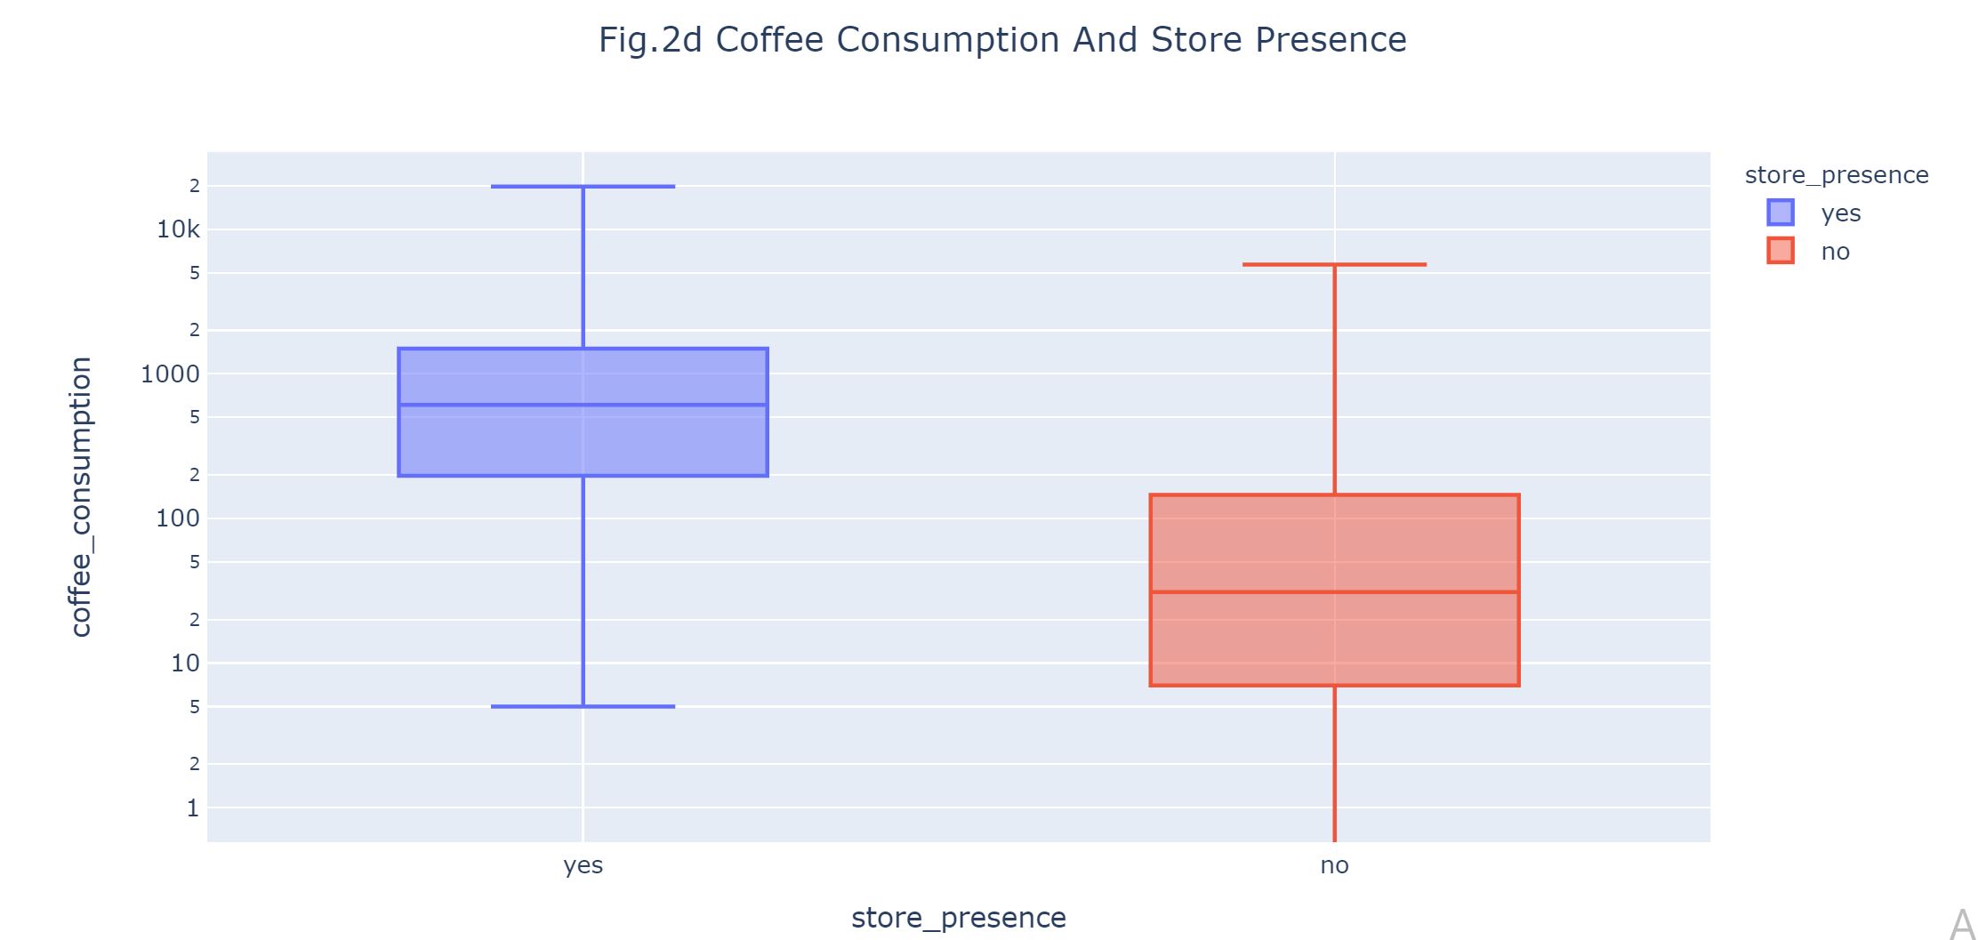

Slide 9
What country currently without Starbucks could be a potential for a new location?

Slide 10
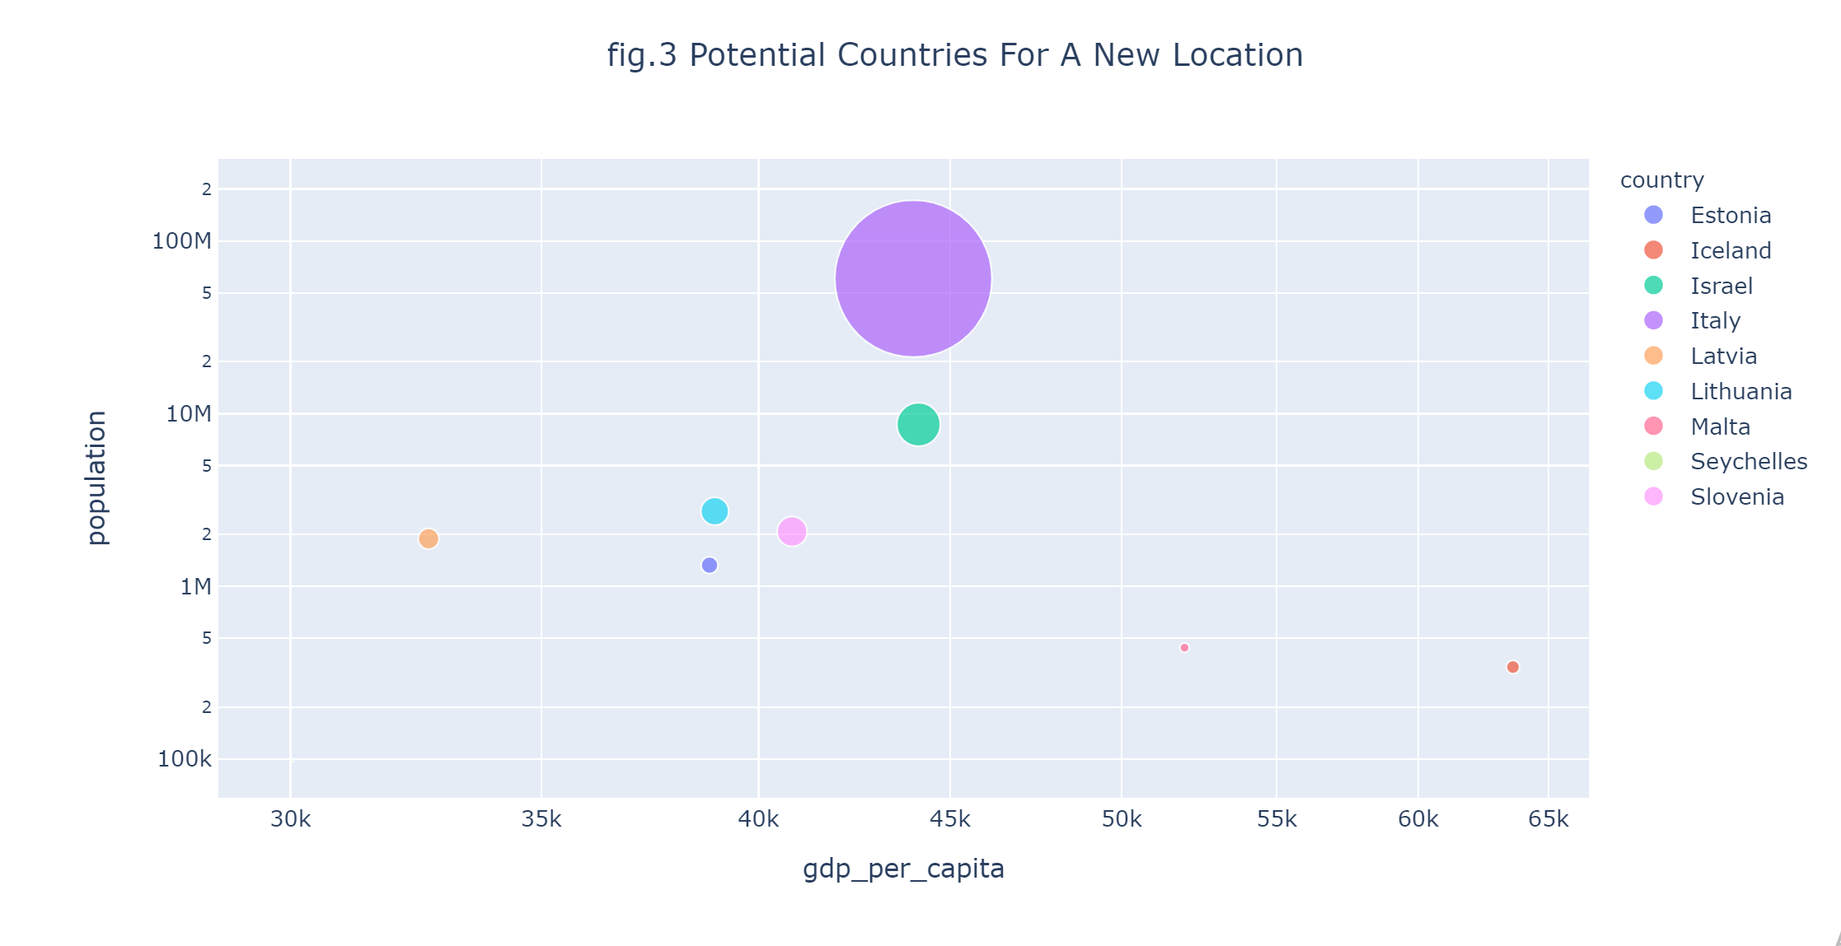

Slide 11
Conclusion
United States has the most Starbucks locations in the world. It is followed by China, Japan, South Korea and United Kingdom. The number of newly opened stores in Asia is growing on a faster rate compared to Europe and Americas.
Countries with Starbucks stores had higher GDP per capita(>=30000), higher population(>=17 million), consumed more coffee(>=610) and performed better in the area of doing business(>=74) than those countries that didn’t have Starbucks store.
With high GDP per capita , population and coffee consumption , Italy and Israel could be a potential countries to open a new Starbucks location.

